Slide 1
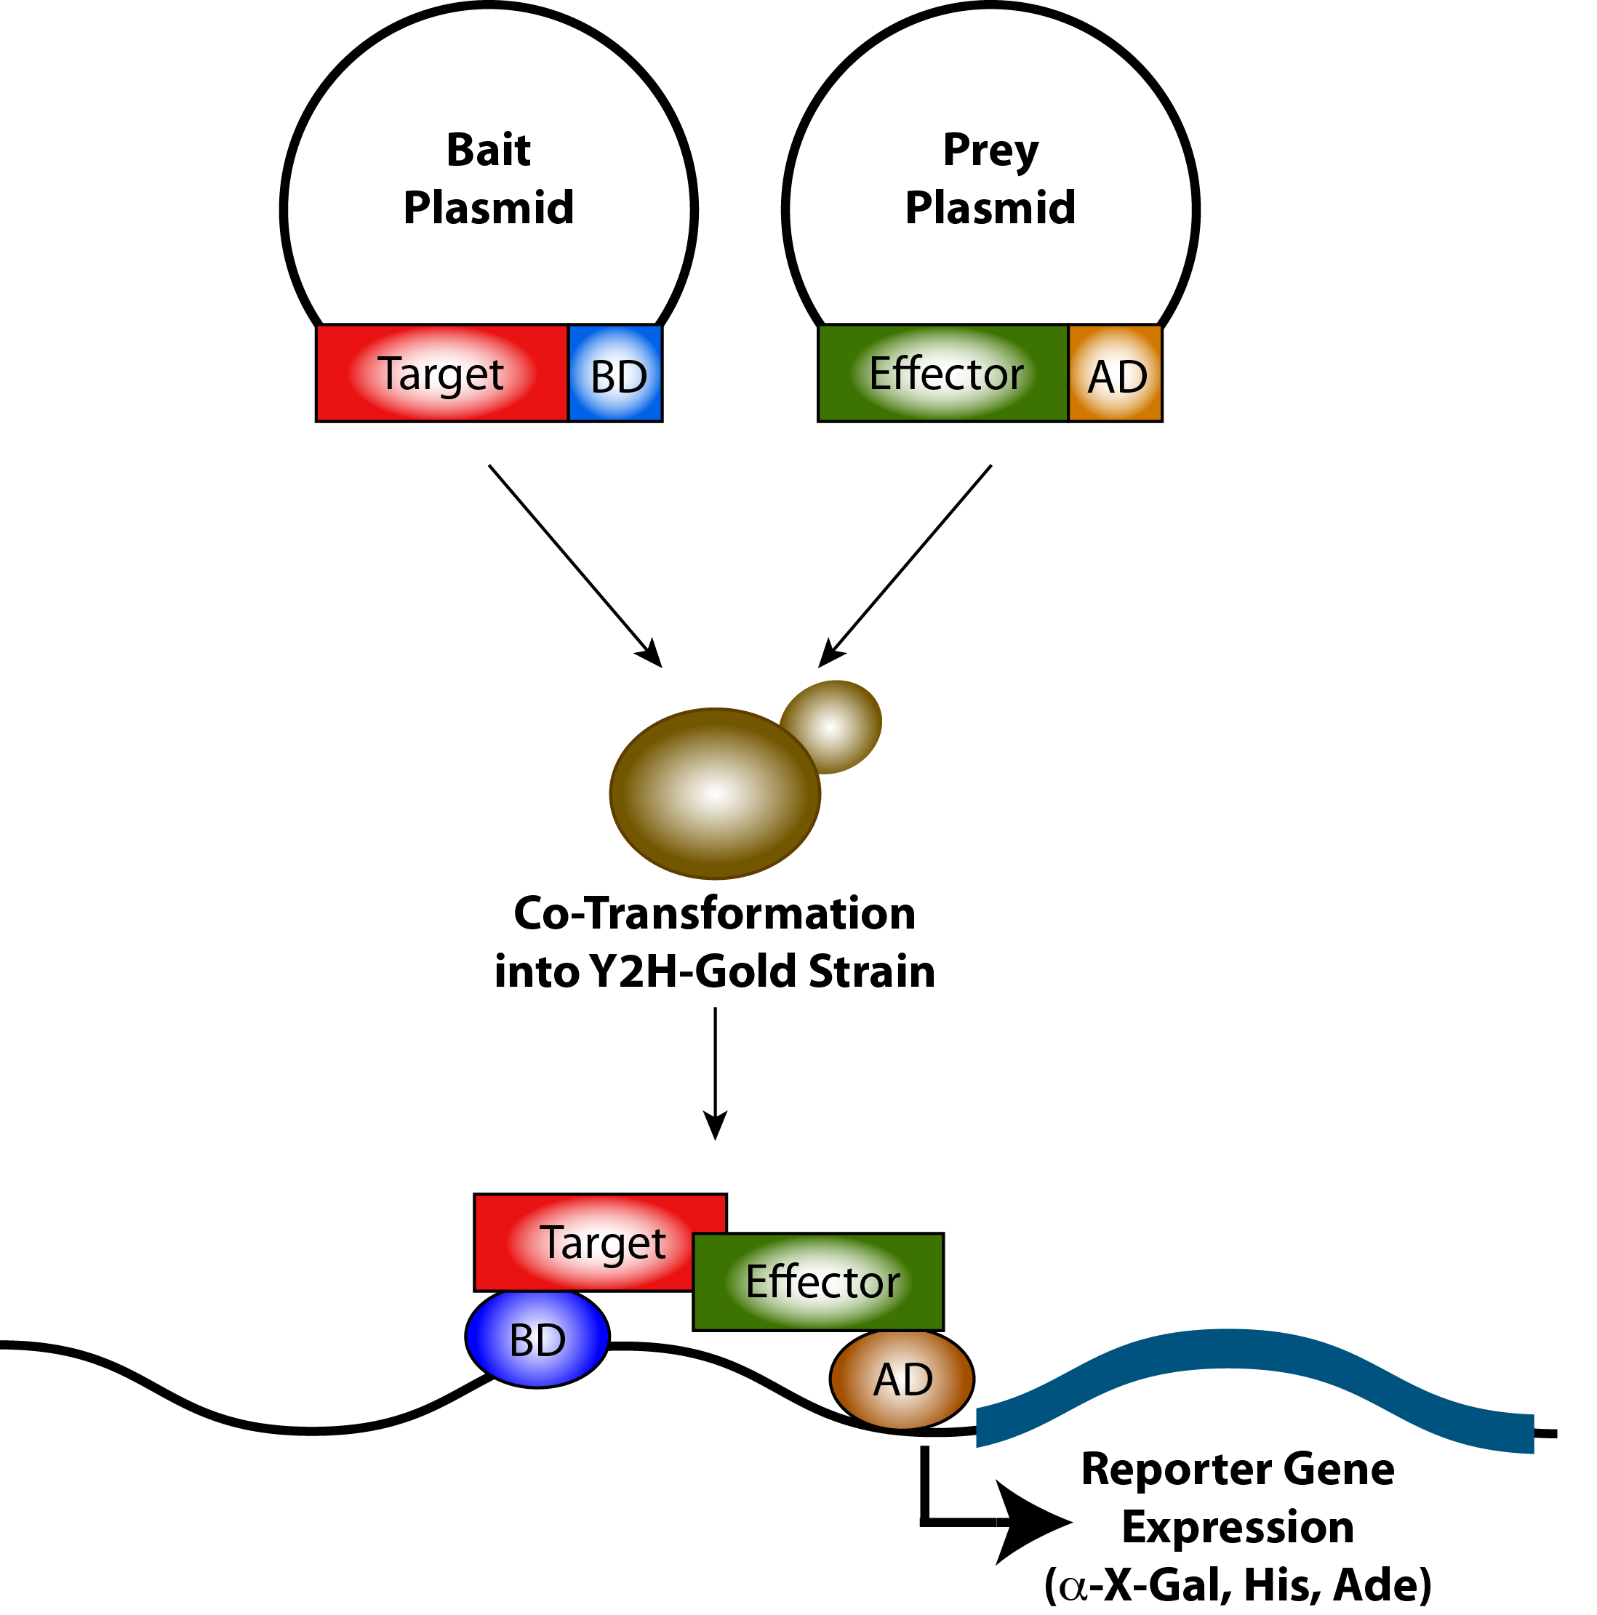
Yeast two hybrid: Basics
Method to investigate protein-protein interaction
Based on the transcription factor Gal4
Gal4 consists of a DNA-binding domain (BD) and an activation domain (AD)
Both domains are functional even when seperated
Both domains need to be in close proximity to activate transcription
Generate fusion proteins in autonomously replicating plasmids (1)
Fusion proteins: 1st POI-Gal4-BD (Bait) / 2nd POI-Gal4-AD (Prey)
Both plasmids are co-transformed into Gal4-deficient Yeast strain (Y2H Gold; (2))
Plasmids complement Leucine and Tryptophan auxotrophy (3)
(Selection on SD –leu/-trp medium)
Bait fusion protein can bind to upstream activating sequences (UAS)
of Gal4-responsive promoter regions
Interacting proteins bring BD and AD in close proximity
POI1-BD/POI-AD complex activate transcription of reporter genes (4)
(Histidine / Adinine / α-Galactosidase / Aureobasidine)
( slection on SD –leu/-trp/-his/-ade +α-X-Gal)
1)
2)
3)
4)
Additional information: Matchmaker III user manual (Clontech)

Slide 2
Yeast two hybrid: The two main methods (Library Screen)
Library screen
Pre-transform bait plasmid
BD
Y2H gold
Grow primary transformant
BD
AD
AD
Transform prey library
AD
AD
BD
AD
Select positive interactors
(SD –leu/-trp/-ade/-his +X-α-Gal)
BD
AD
Extract plasmids
BD
AD
BD
AD
Your Gene of interest
Sequence AD-Plasmid
(to identify interaction partner)
From: Matchmaker™ GAL4 Two-Hybrid System 3 & Libraries User Manual

Slide 3
Yeast two hybrid: The two main methods (Co-transformation)
Material provided:
Co-transformation
Y2H Gold o/n culture (in YPDA medium)
Solutions to prepare competent cells
(H2O, Te/LiAc)
Solutions for Yeast transformation
(PEG/LiAc/TE, DMSO)
Plasmids for Yeast Transformation
(3x bait plasmid containing target genes
2x prey plasmid containing effectors)
BD
1st – 2nd day
Co-transform both plasmids
Y2H gold
Transformation
AD
Select positive tranformants
(SD –leu/-trp = 2xDO)
BD
AD
4th day
Test strains o/n culture (in SD 2XDO medium)
Control strains o/n culture (in SD 2XDO medium)
Y2H Media (2x DO, 4x DO Medium)
Y2H assay
Select positive interactors
(SD –leu/-trp/-ade/-his +X-α-Gal
= 4xDO)
BD
AD
5th - 9th day

Slide 4
Yeast two hybrid: Pros and Cons
Pros:
Cons:
Quick and easy screening method
Yeast is easy to handle in the lab (growth, transformation, selection)
Semi in-vivo conditions
Allows for post-translational modifications (e.g. Glycosylation, Prenylation etc.)
Yeast chaperones support proper protein folding
Depends on nuclear localization
Post-translational modifications in yeast can be different to the natural system
Co-factors might not be present in yeast
False negatives:
Wrong fold of proteins can alter interaction
TM-domains or Prenylation can interfere with nuclear localization
False positives:
Wrong fold can cause unnatural interaction
Proteins which are naturally separated (spatial or temporal) can interact in yeast
Intrinsic activation domain can cause autoactivation in BD-fusion proteins
→ Needs downstream verification by additional experiments

Slide 5
Yeast two hybrid: Verification of Interactions
Methods to verify interaction partners: Pros:
FRET (Förster resonance energy transfer) - in planta conditions, transient expression, does not require protein extraction
Co-Immunoprecipitation (CoIP) - in planta conditions, transient expression, quick
in-vitro interaction studies (e.g. analytical gel filtration) - “clean” environment (no protein modifications/additional proteins), detection of binding affinity, allows to study the mode of interaction (e.g. by protein structure resolution)
Additional Yeast based assays:
Yeast-one-Hybrid - screen for Protein-DNA interaction
Yeast-three-hybrid - screen for Protein-RNA interaction
Split-ubiquitin system - screen for Protein-Protein interaction of membrane proteins

